Slide 1


TEAM FIRE

Slide 2
Because of Fire in 2018… In U.S. 88+ People Killed approx. 7,09,408 acre burned 20,233+ Building Damaged US $17.345 Billion Loss

Slide 3

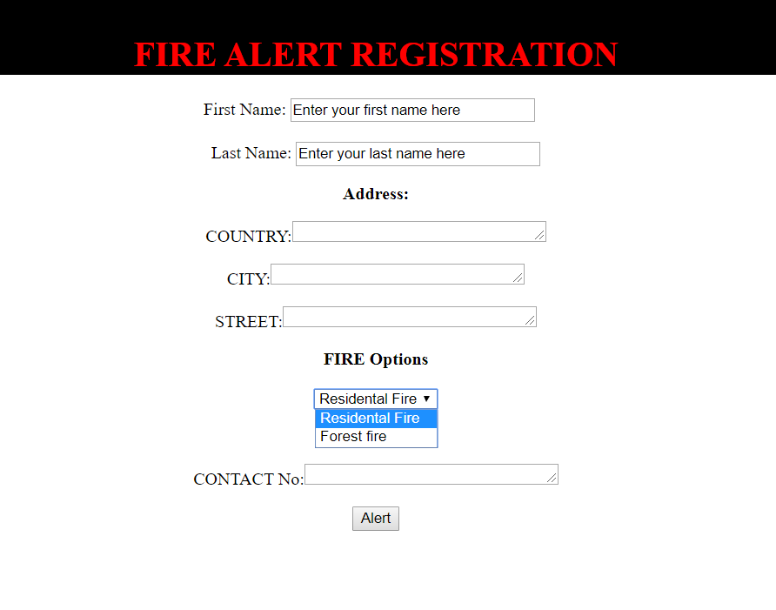
Reporting a Fire :
Fill the Form

Slide 4
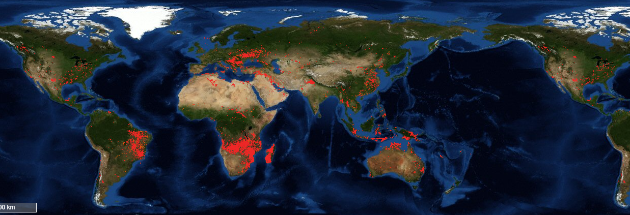
Through Satelite
By the Help of MODIS and VIIRIS,Fire is Detected from Space and Informed
World View Showing Fire From The Satellite Data of VIIRIS and MODIS

Slide 5
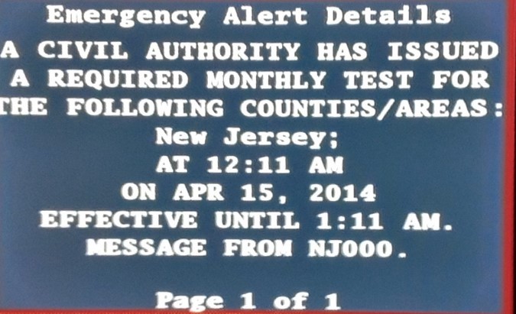
Notify Related People
Nearby People of around affected Area from the fire location With The Help of Emergency Alert System (EAS)
A Required Monthly Test (RMT) transmitted in New Jersey on April 15, 2014 as shown on a television set

Slide 6
People Alerting About The Fire Will Get Message With Important Mobile Numbers

Slide 7

Rescue Team And Fire Department located near to the location will get Information About The Fire and The Place.

Slide 8

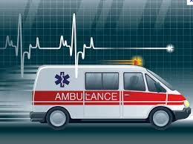
If the Fire Is Forest Fire Then Forest Department Will Get Alert and in case of Residental Fire Ambulance Services And Hospital will be Notified.

Slide 9
As people arrive in the Area of Durning Its Impact.They Will get Notified By the Help Of Cell Phones.
By Data analysis,People Living in Most Fire Risky Places Are Priotize By Messaging Frequently and Fastly If any Fire Sign is Seen.

Slide 10
Let Stop Fire Causalities And Save Life of People as well as Animal
THANK YOU

